Slide 1
Minimizing and recycling waste Plus the environmentally responsible selection of waste disposal service providers
By Taimur Burki

Slide 2
Intel is evolving To a company that powers the data center and billions of smart, connected devices.
Intel’s Vision: If it’s smart and connected, it’s best with Intel.

Slide 3
smart & Green
Intel’s approach to sustainability
Our mission for the coming decade
Pursuing a gentler footprint
Innovation for the planet
Engaging for a sustainable future
Notes:
We are committed to being a leader in environmental responsibility. We strive to continuously improve energy efficiency, reduce emissions, and conserve resources throughout our operations. We also focus on improving the energy-efficient performance of our products, and collaborate with others to develop innovative ways that technology can address long-term sustainability challenges.
Product energy efficiency has become increasingly important in our industry, given the growing demand for more computing, the increasing cost of energy, and the corresponding impact on the environment. According to Gartner Research, about 2% of the world’s emissions come from the information and communications technology (ICT) industry. We are focused on reducing the environmental impact of our products and driving to new levels of energy efficient performance.
Over the past decade, we have reduced key environmental impacts such as greenhouse gas emissions while increasing our manufacturing output. We have been recognized for our sizable renewable power purchases and on-site solar installations, as well as for our leadership in green building practices. In 2012, we made progress toward achieving our new 2020 environmental goals, but continued to face challenges in reducing water use and chemical waste due to the increasing complexity of our manufacturing processes.
Copyright © 2015 Intel Corporation. All rights reserved. Intel and the Intel logo are trademarks or registered trademarks of Intel Corporation or its subsidiaries in the United States and other countries. *Other names and brands may be claimed as the property of others.

Slide 4
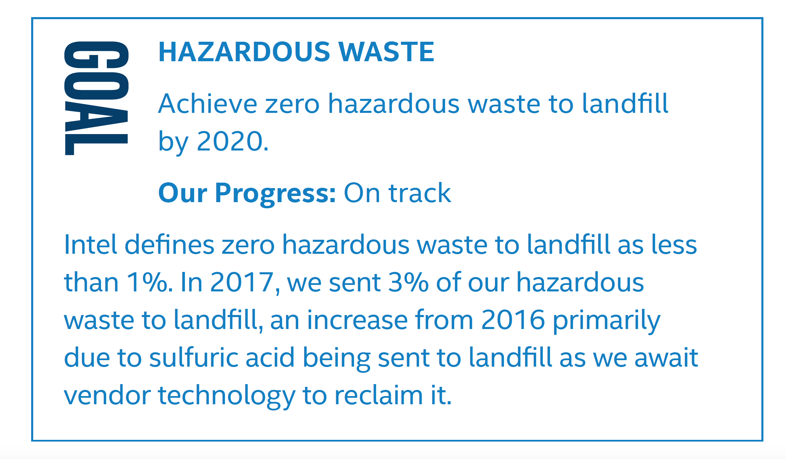
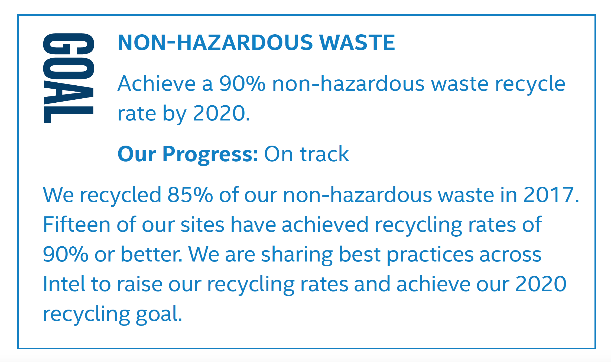
Intel’s Waste Goals
Read more at intel.com/responsibility

Slide 5
Intel Arizona
One of the largest and most complex sites in the world
Moved to Chandler is 1979
Capital Investment of $29 billion in manufacturing at the Ocotillo site since 1996 (Intel established in AZ operations in 1979)
Manufacturing Intel’s latest products
One of the most diverse Intel sites: Manufacturing, Research & Development, Assembly Test, Logistics, Chip Design, Marketing, Internet of Things, IT, Finance, HR, Legal
The largest employer in Chandler, 7th largest in AZ, largest manufacturer

Slide 6
WASTE: Changes in expectations
In the 1990s solid waste recycling was considered innovative.
Now its considered a must do by society and is an expectation.
Increasingly there are opportunities to “upcycle” our wastes creating a circular economy.

Slide 7
Historical Non Hazardous Waste
2020 Goal of 90%
90%
90%
88%
85%
84%

Slide 9
How do you manage waste?
What is a waste
What is it made of
What could you do with it

Slide 10
Where do you start?
Define your goals
Stop thinking of waste as waste, it’s a product
Where is it generated?
Know your infrastructure
Put it in a contract
Review the data
Go with recycling centers vs cubicle waste bins
Think about what else could be done with this project - go visionary!

Slide 11
How Do WE get to 90%? This was the Challenge of 2013… and Still is
Linked Recycling Results to the Employee Bonus. Challenge that by Q4 of 2013 we would be at 90%
We removed all Styrofoam containers and went to compostable dishware and then to re-usable dishware
Composting of food waste
Removed individual trash and recycling bins in cubicles
Quarterly reports to executive management with extensive site engagement, data analysis and education
Donations to local schools:
Copper to ASU College of Fine Arts for sculpture & jewelry
Wood crates to Desert Botanical Garden

Slide 12
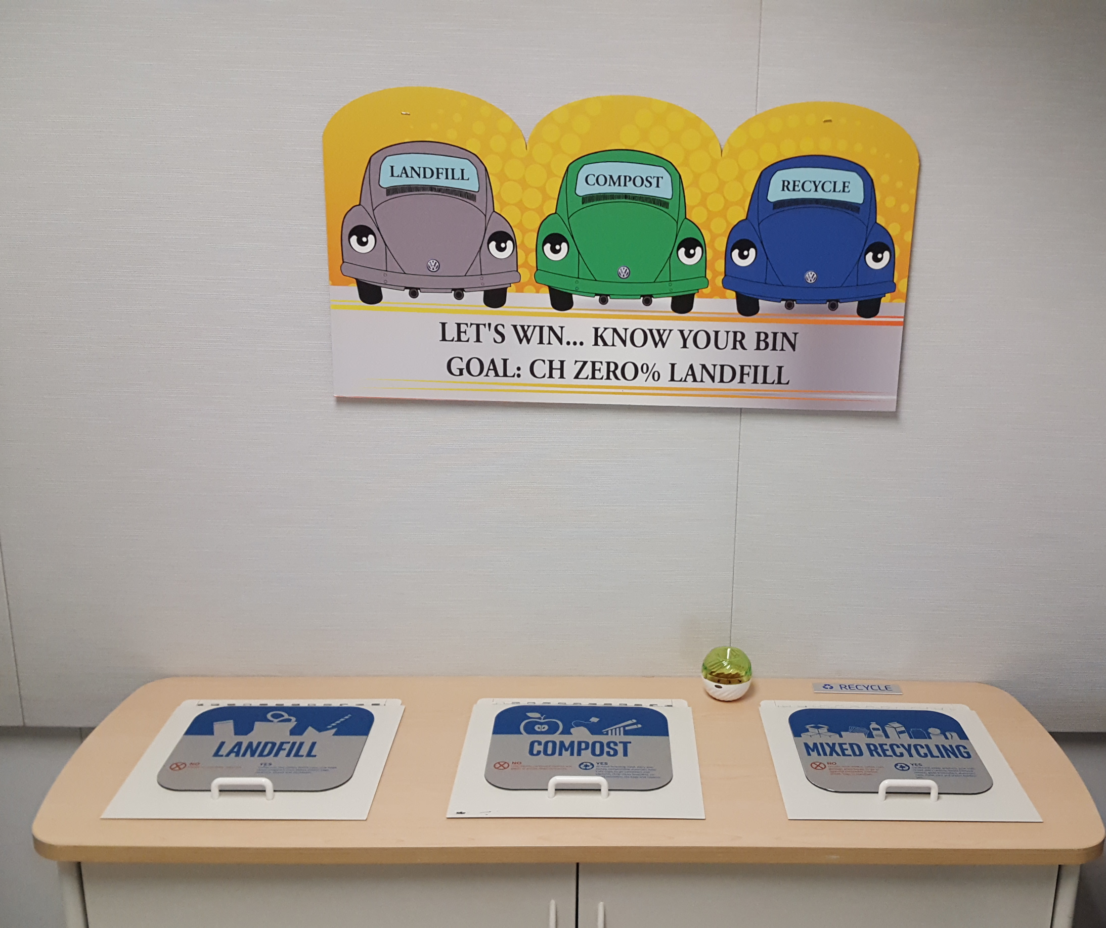
Make it easy and obvious
Established recycling centers in each building
One center per 20K sq/ft of office space
Signs to explain the goals and segregation strategy at each location

Slide 13
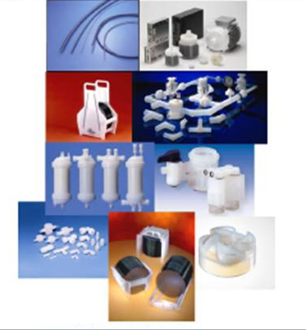
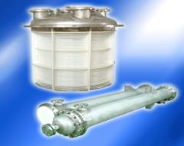
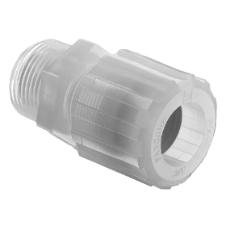
PFA (PerFluoroAlkoxy) Circular Economy
Current Situation:
PFA which is a fluoropolymer which is chemically inert and solvent resistant to virtually all chemicals
It is not recyclable and when sent to recyclers then to landfills
Solution:
Recycle PFA back into PFA
De-installs:
Have the trades take all clear plastic pipes to one location onsite
Send this back to the manufacturer
Installs:
Scraps/Excess go to a single bin and send back to the Manufacturer

Slide 14
Waste Vendor Selection
What is your level of acceptable risk?
What information is publicly available on ECHO?
What is the compliance history?
Is it a superfund site or has groundwater contamination
Can you walk the site?
What is their safety incident rate
Are there any issues with the local community?

Slide 15
Questions?
First, read the latest CSR report at intel.com/responsibility
Contact me at Taimur.k.Burki@intel.com or (480) 715-2273

